Slide 1
Project Overview
© 2015 – v1.0 Apr’15 | Able One Systems S.r.l.

Slide 2
Project Overview
Market
Solution
S&D
Team
1/3
“Following the daily news, it is easy to get the impression that the European economy is dominated by large, multinational enterprises. Their multi-billion Euro takeovers, global expansion plans or -more recently- risks of mega bankruptcies dominate the headlines.
What usually gets lost is that more than 99% of all European businesses are, in fact, SMEs. They provide two out of three of the private sector jobs and contribute to more than half of the total value-added created by businesses in the EU. Moreover, SMEs are the true back-bone of the European economy, being primarily responsible for wealth and economic growth, next to their key role in innovation and R&D.
What is even more intriguing is that nine out of ten SMEs are actually micro enterprises with less than 10 employees. Hence, the mainstays of Europe's economy are micro firms, each providing work for two persons, in average. This is probably one of the EU's best kept secrets!”
The SME business environment in Europe
92%
European Commission: Annual Report on European SMEs
Sources: Eurostat, National Statistical Offices, London Economics
© 2015 – v1.0 Mar’15 | Able One Systems S.r.l.

Slide 3
Project Overview
Market
Solution
S&D
Team
2/3
“Economists have theorized that e-commerce ought to lead to intensified price competition, as it increases consumers' ability to gather information about products and prices” …
… “The lone exception to this pattern has been the very smallest category of bookseller, shops with between one and four employees, which appear to have withstood the trend.”
(The Economist. 3–9 July 2010. p. 78
Economics focus: “The click and the dead”)
'The SMEs that communicates' Alberto Dal Sasso, Director of Nielsen Media division
High Costs and Low Return On Investments
© 2015 – v1.0 Mar’15 | Able One Systems S.r.l.

Slide 4
Project Overview
Market
Solution
S&D
Team
3/3
“by 2015, local online ad spending will make up nearly one-quarter of all advertising by local businesses”
Traders, tired of the high cost and poor results from investments in flyers and newspaper advertisements have embraced new technologies in complete autonomy, hoping at least to reach a wider number of consumers and certainly with a lower cost.
Mailing lists, Web pages, socials and many mobile apps are full of ads; retailers are trying every possible means to improve the way to reach as many as possible consumers, but once more the results aren’t coming as expected; for sure investments decreased, but without boosting actual sales.
All these clues acquired investigating the market lead to a strong conclusion: the market is ready for Rumorants. Traders and consumers are trying to find the best way to employ available technology in order to maximize advertising efficiency and Rumorants is the best solution to achieve that goal.
“by 2015, two-thirds will come from mobile ads on tablets, smartphones and GPS-enabled laptops”
© 2015 – v1.0 Mar’15 | Able One Systems S.r.l.

Slide 5
Project Overview
Market
Solution
S&D
Team
1/3
Traders and consumers are trying to find the best way to employ available technology in order to maximize advertising efficiency and Rumorants is the best solution to achieve that goal. Its strength is that all project has been lead by the will to optimize communication among people, transferring this approach to local advertising the result was exceptional.
Retailers
Insert ads
Require ads
Consumers
Retailers will reach only truly interested consumers
Consumers will find only ads he asked for
A simple, intuitive, immediate mobile application where buyers and sellers may meet and then contact themselves to conclude their trade. The market niche is not approached to gain on transactions as eBay or Amazon, but to avoid smaller companies to fight their daily expensive battle to reach truly potential customers and to avoid consumers to be drowned by sterile and noisy advertising.
© 2015 – v1.0 Mar’15 | Able One Systems S.r.l.

Slide 6
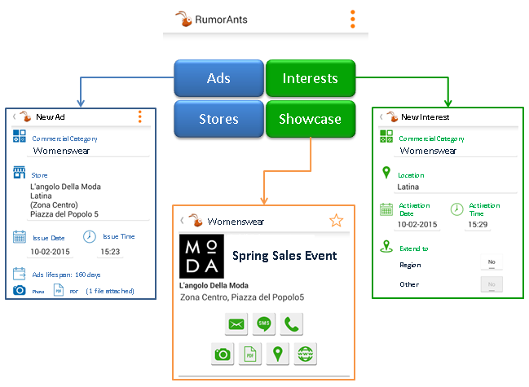
Project Overview
Market
Solution
S&D
Team
2/3
How it works
The application performs automatic updates. Every few minutes it checks all Interests and Ads posted by users and verifies matching.
All the matched Ads will be directly shown on the Showcase and notified through the mobile platform features.
1
2
3
The best place where retailers and customers may meet.
© 2015 – v1.0 Mar’15 | Able One Systems S.r.l.

Slide 7
Project Overview
Market
Solution
S&D
Team
3/3
The analysis carried out on the market and its potential competitors highlighted the uniqueness of Rumorants, which encloses a set of advantages unidentified in any other existing product, both for retailers and consumers.
Rumorants has the ambition to become the reference tool in the local advertising market.
© 2015 – v1.0 Mar’15 | Able One Systems S.r.l.

Slide 8
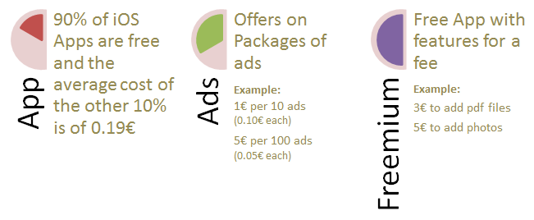
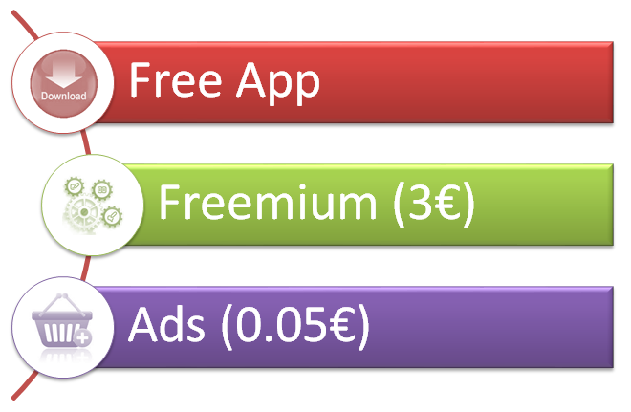
Project Overview
Market
Solution
S&D
Team
1/1
Estimated Revenues
Retailers will be about the 10% of users and only the 7% of them will buy additional features. Each retail will post about 100 ads each month for a cost of 5€. These figures can be yearly summarized in streams as follows
100,000
Users
621,000€
© 2015 – v1.0 Mar’15 | Able One Systems S.r.l.

Slide 9
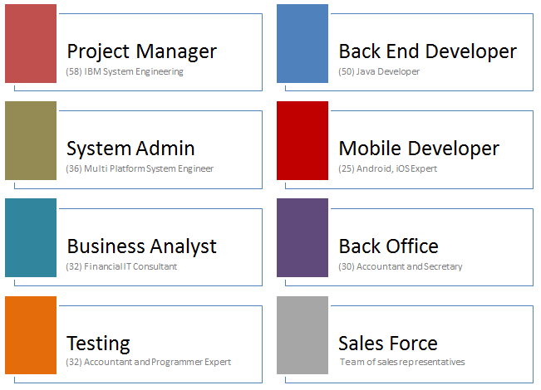
Project Overview
Market
Solution
S&D
Team
1/1
electronic engineer grew in IBM, which consolidated his experiences becoming owner of a company that offers consulting service to major Italian and multinationals companies
Senior Java Developer that can boast more then twenty years of experience in Telcos
almost twenty years of experience as System Administrator both on Linux and Windows Platforms in nationwide and multinational environments
graduate in computer engineering, with special interest in multiplatform mobile development
degree in economics and a background that crosses from Finance Accounting and IT software development in multinational environment
© 2015 – v1.0 Mar’15 | Able One Systems S.r.l.

Slide 10
Project Overview
Thank You !!!
© 2015 – v1.0 Mar’15 | Able One Systems S.r.l.

